Slide 1

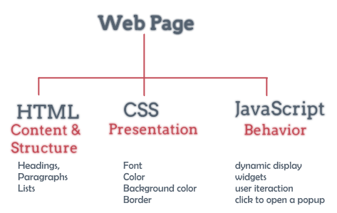
Hypertext Markup Language
(HTML) Part 1

Slide 2
Lesson Objectives
Understanding the concept of HTML
Learn how to use and attach HTML tags to build a static web page
Know how to arrange objects on the website

Slide 3
Lesson content
Introduction to HTML
Structure of an HTML document
Basic tags
List tags
Page link tag

Slide 4
1. Introduction to HTML
HTML = HyperText Markup Language – The most basic language for building websites.
HTML was invented by Tim Berner Lee and standardized by W3C (World Wide Web Consortium) in 1994

Slide 5
1. Introduction to HTML
HTML uses sets of markup symbols commonly known as tags to format how data is displayed.
Browsers usually do not report syntax errors for the HTML language. If you write the wrong syntax, it will only lead to the displayed results not as intended.

Slide 6
1. Introduction to HTML
HTML file with text content including small tags
Display tags tell the browser how it should render the page
There are many HTML editors that allow users to edit visually, resulting in corresponding HTML such as:
Visual code
Visual Studio
Microsoft Expression Web
Notepad, Notepad ++
Eclipse
…

Slide 7
1. Introduction to HTML
File extensions:
home.html or
home.htm
Open the file with a web browser or double click on the saved html/htm file.

Slide 8
1. Introduction to HTML
For example:
HTML Code | Show in browser
This is web page <b> This is web page </b> | This is web page This is web page
The above example shows, the same data is the text line "This is web page", but when we use the format of the <b> tag in the 2nd line, the displayed result will be different.

Slide 9
1. Introduction to HTML
Most HTML tags have a start tag (opening tag) and an end tag (closing tag) respectively.
The end tag is similar to the start tag, the only difference is that it adds the "/" character before it.
The opening and closing tags are both enclosed in:
<start tag> data </end tag>
start tag = end tag
Some tags don't need a closing tag
<img />, <br />

Slide 10
1. Introduction to HTML
The tags are case-insensitive:
<HTML> = <Html> = <html>
Ignore extra spaces and line breaks, line breaks between data text and tags, for example:
Data 1 | Data 2 | Data 3
Wishing you all Study Well | Wishing you all Study well | Wishing you all Study well
→ Wishing you all Study well

Slide 11
2. HTML Structure document
<html>
<head>
<meta charset="UTF-8">
<title> This is the title of the website </title>
</head>
<body>
This is the main content of the website
</body>
</html>

Slide 12
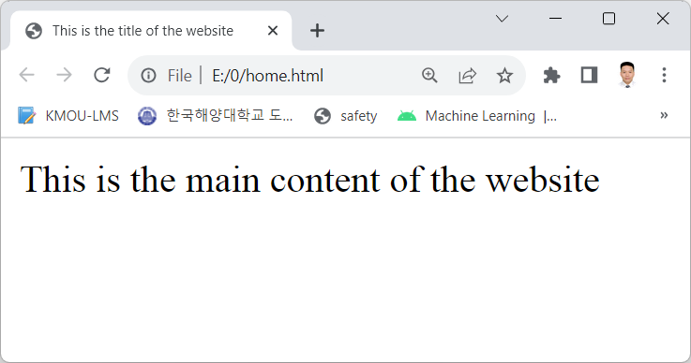
2. HTML Structure document
<html>
<head>
<meta charset="UTF-8">
<title> This is the title of the website </title>
</head>
<body>
This is the main content of the website
</body>
</html>

Slide 13
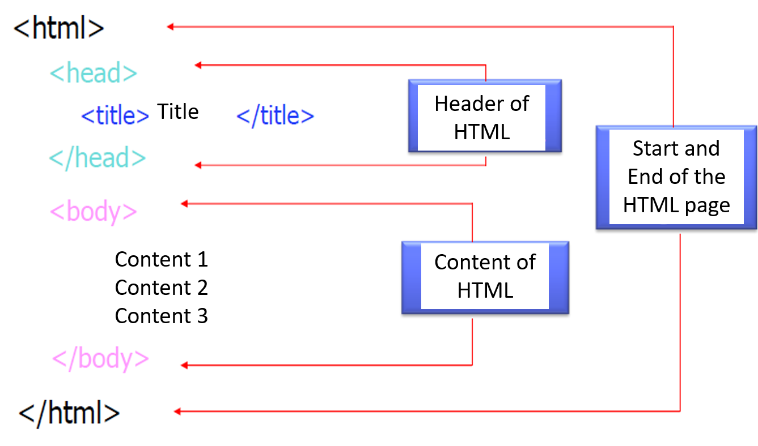
2. HTML Structure document

Slide 14
2. HTML Structure document
A tag usually has 3 or 4 parts :
Name of the tag: used to identify the function of the tag
Attribute of the tag: used to identify how the data is displayed.
The value of the tag attribute
Or have additional child elements between the opening and closing tags of the tag

Slide 15
2. HTML Structure document
Tag declaration :
<tag_name attribute1 = "value1" attribute2 ="value2" >
Content
</tag_name>
Attention: :
Can change the order and number of attributes without causing syntax errors
The support for tags, attributes in each browser is different. Just the same in tags, basic attributes.

Slide 16
2. HTML Structure document
For example::
<div style= "font-size: 30px">Big size of Font</div>
<img src= "myavatar.png" title= "image title" />

Slide 17
2. HTML Structure document
HTML text is edited as usual, more note:
Every space, carriage return in HTML displayed on the web page is a single space.
To type some special characters we have to use the CODE:
Blank space (in case more than 1 blank character is desired): &nbsp;
Less than (<) and greater than (>) signs: &lt; &gt;
Quotes (“): &quot;
Symbol ©: &copy;
…
Comments in HTML: <!-- Comments -->

Slide 18
3. Basic tags
Tag Heading
Tags in HTML page content
Character Format Tags
Tag Decoration pictures
Attributes that set the Page Background Color and Layout

Slide 19
Tag Heading
Opening tag | Closing tag | Description
<h1> <h2> <h3> <h4> <h5> <h6> | </h1> </h2> </h3> </h4> </h5> </h6> | Format lines of text according to the heading hierarchy. The size of the characters gets smaller from 1 to 6 After each tag, the text is automatically newline. Attributes: align=“how to align margin” left, right, center, justify

Slide 20
Tags in HTML page content
Opening tag | Closing tag | Description
<body> | </body> | Contents of the Website
<!-- | --> | HTML page comments
<p> | </p> | Declare paragraph, insert a newline character and a blank line. Atributes: align=“how to align marg”: left, right, center, justify
<br /> |  | Create new line

Slide 21
Tags in HTML page content
Opening tag | Closing tag | Description
<div> | </div> | Declare a text area (lines)
<span> | </span> | Declare a textarea (on one line)
<header> | </header> | *HTML5: Declare the text header area
<footer> | </footer> | *HTML5: Declare the text end area
<section> | </section> | *HTML5: Declare a textarea (like a div)
<nav> | </nav> | *HTML5: Declare a group of navigation links

Slide 22
Character Format Tags
Choose font and font format:
Opening tag | Closing tag | Description | For example
<b> | </b> | Bold | <b>Obama</b>
<i> | </i> | Italic | <i>Obama</i>
<u> | </u> | Underline | <u>Obama</u>
<tt> | </tt> | Fixed-width text | <tt>Obama</tt>
Obama Obama Obama Obama

Slide 23
Character Format Tags
Choose font and font format:
Opening tag | Closing tag | Description
<sub> | </sub> | Subscript, Example: H₂O
<sup> | </sup> | Supperscript, Example: X²
<font> | </font> | Format size, color, font style, .... <font face = ??? size = ??? color = ???> … </font>

Slide 24
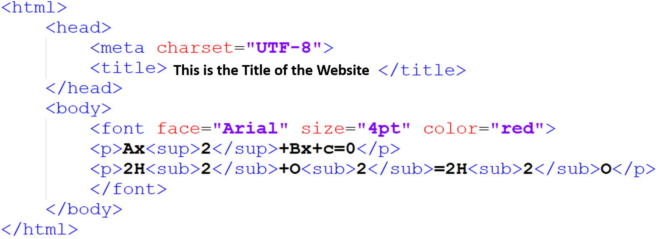

Character Format Tags
Choose font and font format:

Slide 25
Tags decorate pictures
To insert an image into an HTML page, use the <img> tag.
Lưu ý: thẻ này không cần có thẻ đóng.
Tag atributes:
src: specify image file name
height: the height of the image
width: width of the image
alt: specifies an alternative character string for the image in case the image is not displayed
align: align left, right, center
title: image title (displayed on mouseover)

Slide 26
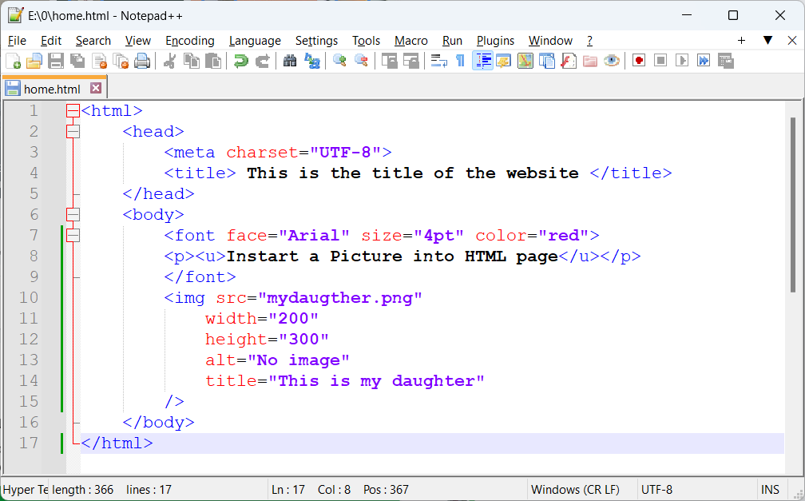

Tags decorate pictures

Slide 27
Attributes that set the Page Background Color and Layout
Color value recorded with combination: RRGGBB
RR: red
GG: green
BB: blue
Each color component is recorded in hexadecimal (number system 16) from 00 to FF .
The lowest value of 000000 is black
The highest value is FFFFFF which is white
Or we can use predefined color names such as: red (red), yellow (yellow), ....

Slide 28
Attributes that set the Page Background Color and Layout
The hex color value can be abbreviated: #RRGGBB → #RGB
Color | Color 3 digit HEX | Color 6 digit HEX | Color RGB
 | #000 | #000000 | rgb(0,0,0)
 | #F00 | #FF0000 | rgb(255,0,0)
 | #0F0 | #00FF00 | rgb(0,255,0)
 | #00F | #0000FF | rgb(0,0,255)
 | #FF0 | #FFFF00 | rgb(255,255,0)
 | #0FF | #00FFFF | rgb(0,255,255)
 | #F0F | #FF00FF | rgb(255,0,255)
 | #888 | #888888 | rgb(136,136,136)
 | #FFF | #FFFFFF | rgb(255,255,255)

Slide 29
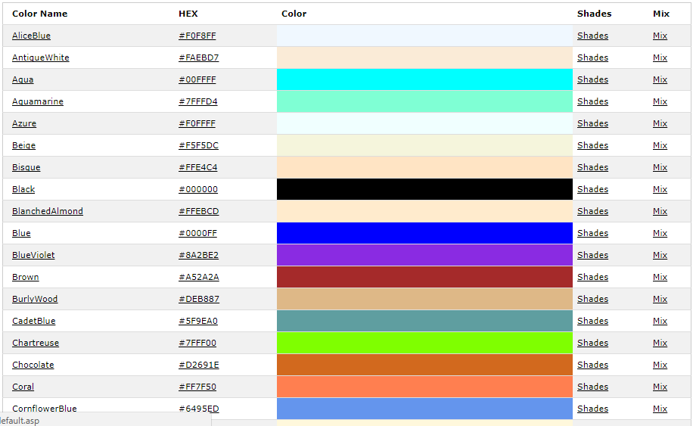
Attributes that set the Page Background Color and Layout
https://www.w3schools.com/tags/ref_colornames.asp

Slide 30
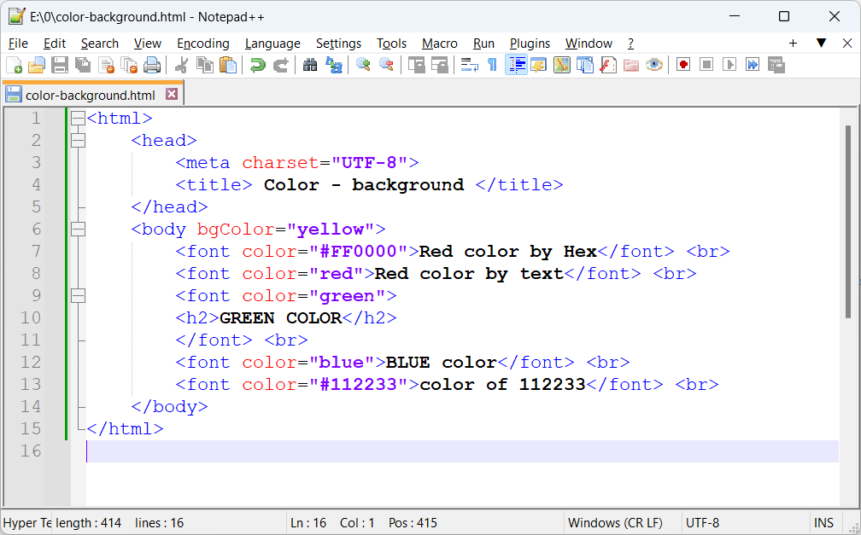
Attributes that set the Page Background Color and Layout
Example background color and text color:

Slide 31
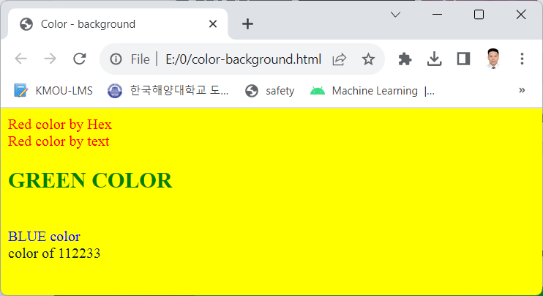
Attributes that set the Page Background Color and Layout
Text color background color results:

Slide 32
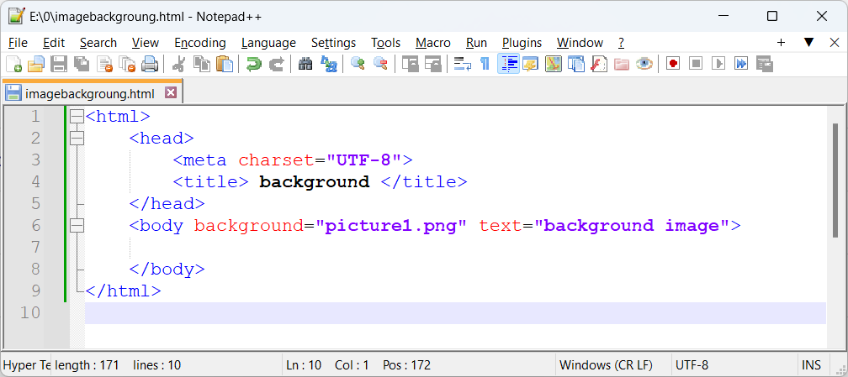
Attributes that set the Page Background Color and Layout
Can use background instead of bgColor

Slide 33
4. List tags
HTML supports the presentation of headings in the form of buttons or numbering.
(Ordered list - OL) | (Unordered List – UL)
1. Item 1 2. Item 2 3. Item 3 | Item 1 Item 2 Item 3

Slide 34
4. List tags
HTML supports the presentation of headings with buttons or numbering
Numbered list of headings <ol>
Each list item begins with <li>
Syntax: <ol type = Numbering style >
Numbering style | Character type used for numbering
I 1 (Default) A a | Use roman numerals I, II, III, .... Use lowercase digits 1,2,3,... Use the characters A, B, C, ... Use the characters a,b,c,...

Slide 35
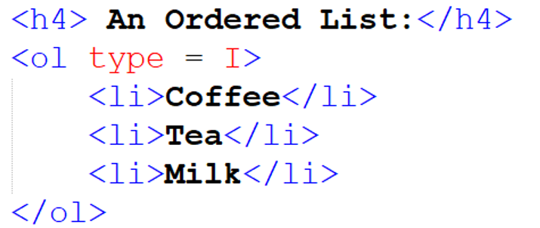
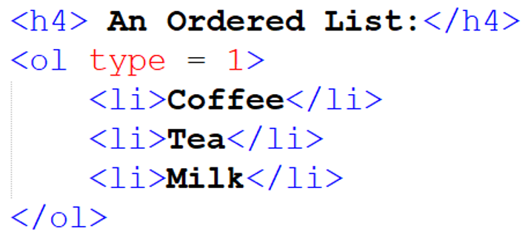
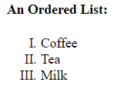
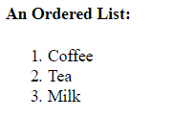
4. List tags

Slide 36
4. List tags
Lists without ordering numbers <ul>: The default is bullets, you can use the Type property to change the format
Syntax: <ul type = list style >
Each list item begins with <li>
List style | Bullet style for highlighting
Square Circle Disc (Default) | Bullet is the filled square. Bullet is a hollow circle. Bullet is full circle.

Slide 37
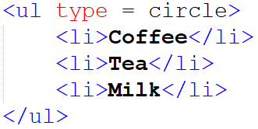
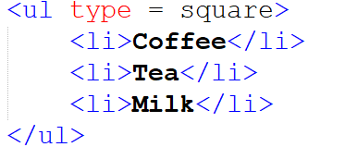


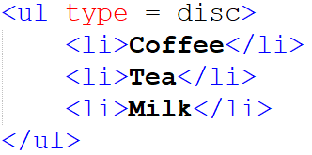

4. List tags

Slide 38
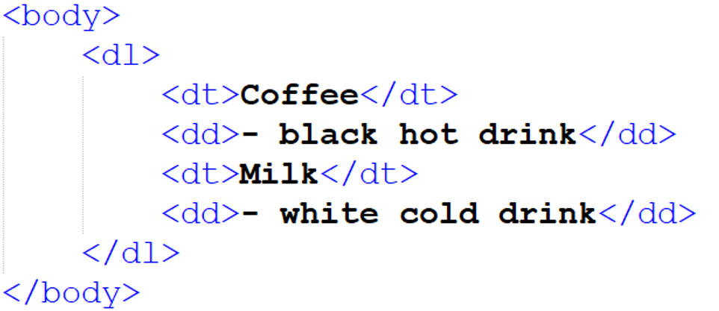
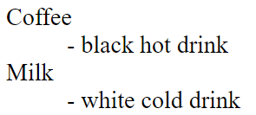
4. List tags
The list of headings has an interpretation that starts with <dl> and ends with </dl> where each item in the list <dt> is a keyword, <dd> is an interpretation.

Slide 39
5. Page Link Tag
HTML feature that can link different pages or sections within the same page together using <a> and </a> tags
We define:
The object used to click the mouse is: Link object. Objects can be: text, images.
The content address will be shown as Link Destination

Slide 40
5. Page Link Tag
Attributes:
href=“link destination”: If the link is the same web location, it should be used relative path.
target=“target window name”. There are some special names :
_self: current window
_blank: New window
title: link title (appear when moving the mouse in)
Page linking is done using <a></a> tag with different levels (4 levels):

Slide 41
5. Page Link Tag
Link to another section located on the same current page :
Put a name at the beginning of the sections to be linked to :
<a name=“#intro”><h1>1. Introduction</h1></a>
At each link point is placed with the keyword :
Please read <a href=“# intro”> Content of Introduction</a> to know the content of the course.

Slide 42
5. Page Link Tag
Link to a section located in another page (stored in the same directory as the current page):
Put a name at the beginning of the sections to be linked to:
<a name=“#intro”><h1>1. Introduction </h1></a>
In another HTML page the link point is set with the keyword:
Please read <a href=“introduction.html#intro”>Introduction</a> to know the content of the course.

Slide 43
5. Page Link Tag
Note: HTML5 no longer has the name attribute in the a tag
→ use id to link in page
For example :
Set the id for at the tag to link to
<h1 id=“title”>This is title</h1>
Create a link to that tag :
<a href=“#title”>Title</a>

Slide 44
5. Page Link Tag
Link to the website address or a specific page on the website (you just need to write directly the address of the page you want to link to)
Affiliate sites :
<p><a href=“http://www.uel.edu.vn”> UEL</a></p>
<p><a href=“http://www.google.com”> Google</a></p>
<p><a href=“https://www.tranduythanh.com”> My Page</a></p>

Slide 45
5. Page Link Tag
Link to Email Address :
<p><a href=“mailto:thanhtd@uel.edu.vn”> Tran Duy Thanh</a></p>

Slide 46
5. Page Link Tag
For example we have 2 pages:
Page1.html
Page2.html

Slide 47
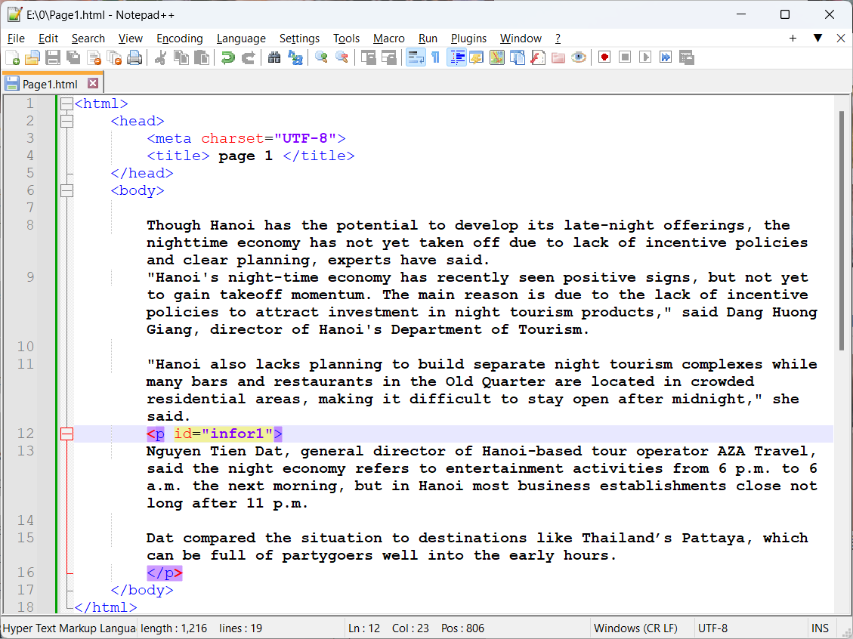
5. Page Link Tag
Page1.html

Slide 48
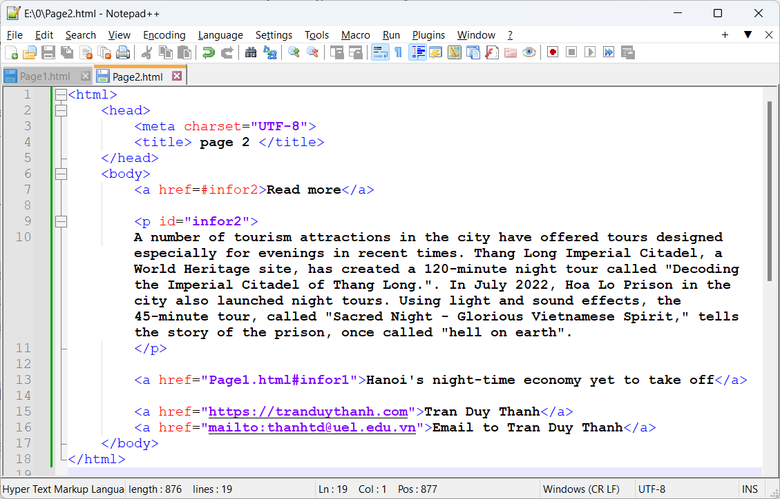
5. Page Link Tag
Page2.html

Slide 49


Hey! Coding is easy!
END

